Slide 1

Final project presentation:
Berlin, 09.08.2022
Stephanie Fosso
& Weiling Peng
How popular will your video be on YouTube?
1 of 10
www.wbscodingschool.com

Slide 2
problems
solution
CHALLENGES
Agenda
2 of 10
www.wbscodingschool.com

Slide 3


A data-based solution project for – Miguel
Miguel has 2 problems
Want to get videos popular/trended
Spend hours every day to read comments from audience
3 of 10
www.wbscodingschool.com

Slide 4
problems
solution
CHALLENGES
Agenda
4 of 10
www.wbscodingschool.com

Slide 5

Big data shows a better channels
–
Pets & Animals
New positioning channel
Current channel
5 of 10
www.wbscodingschool.com

Slide 6
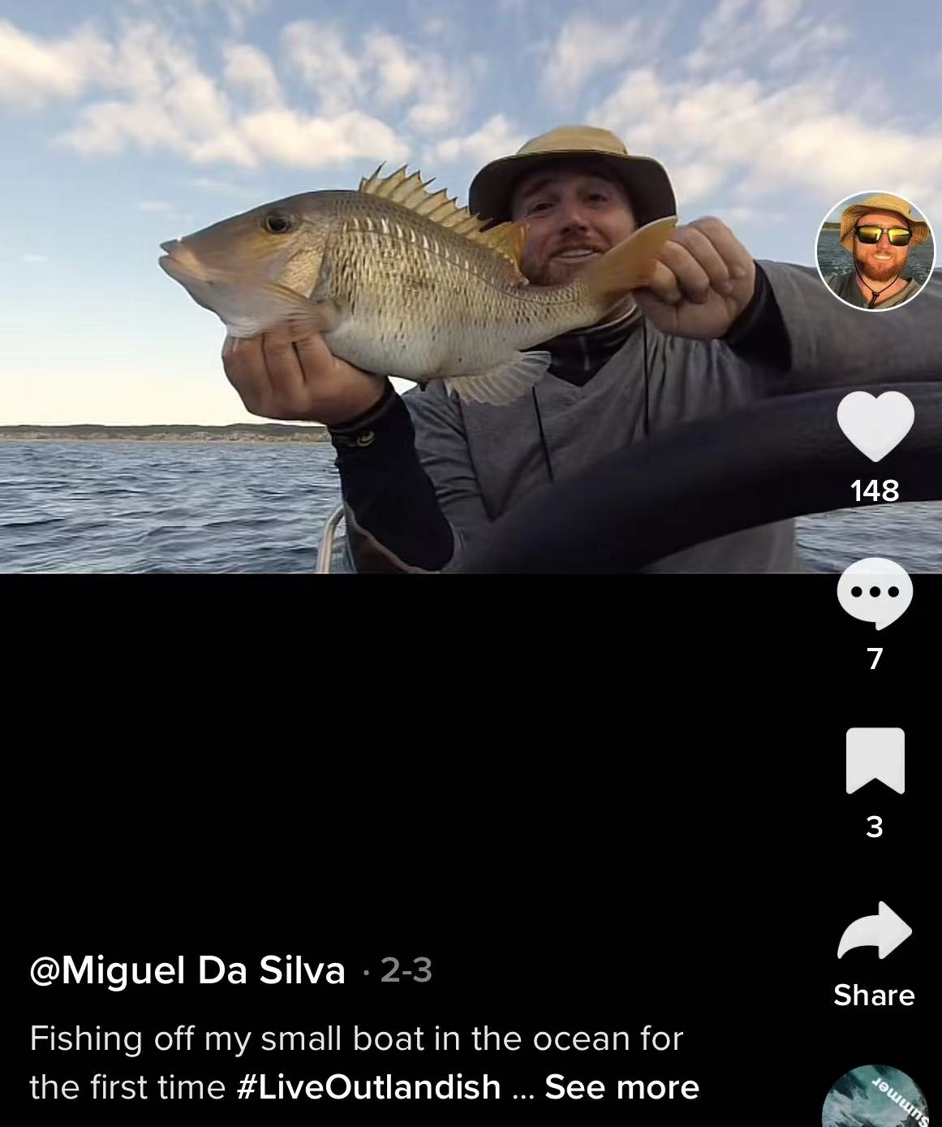

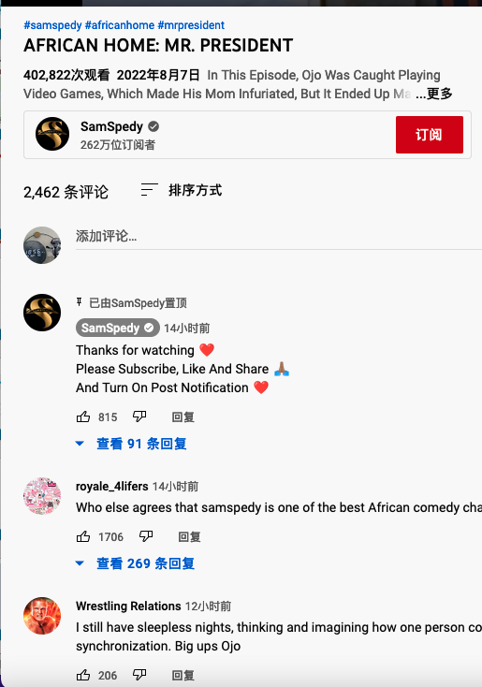
Before posting videos -
Check the trending probability
Title
Chance to be popular
is
84% : )
Tag
Description
channel
category
6 of 10
www.wbscodingschool.com

Slide 7
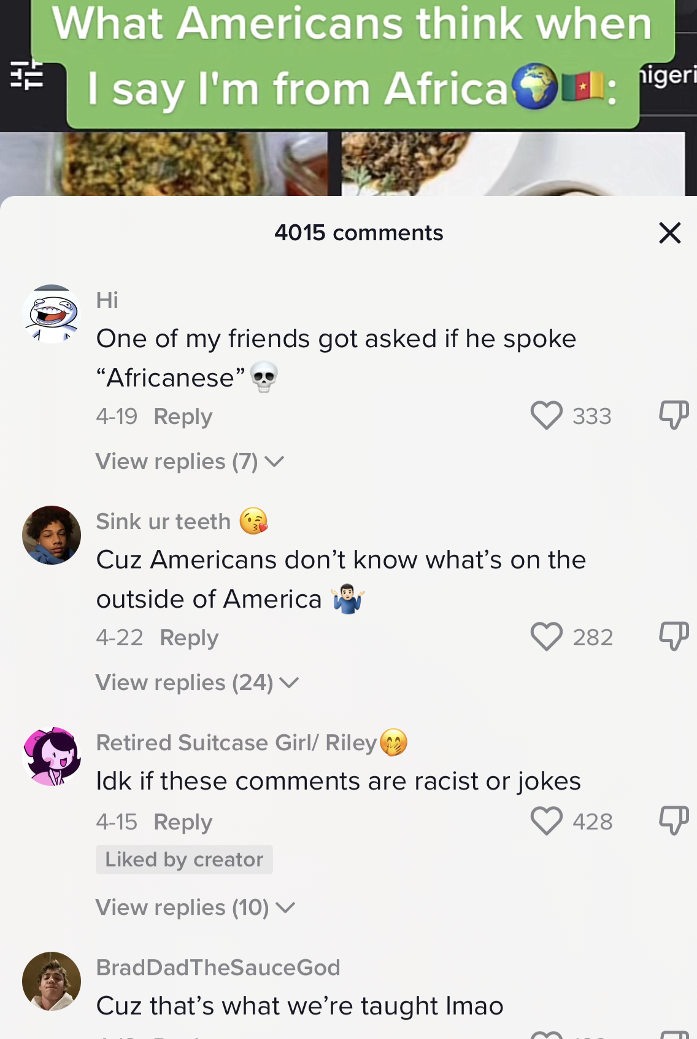
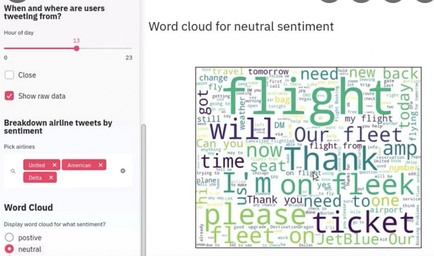
Let computer work for you
- Machine Learning sentiment comments
7 of 10
www.wbscodingschool.com

Slide 8
problems
solution
CHALLENGES
Agenda
8 of 10
www.wbscodingschool.com

Slide 9

Keeping an Eye on Trends is Crucial in the Digital World
New algorithm : we need to always keep an eye on market changes
External factors : keep topical interests, how your competition is performing,
create relevancy to the current season
……..
9 of 10
www.wbscodingschool.com

Slide 10
Sub-fields of this Data Science Project
• 𝗠𝗮𝗰𝗵𝗶𝗻𝗲 𝗟𝗲𝗮𝗿𝗻𝗶𝗻𝗴 (” 𝗖𝗹𝗮𝘀𝘀𝗶𝗳𝗶𝗰𝗮𝘁𝗶𝗼𝗻, 𝗡𝗟𝗧𝗞 ”)
• Python ,pandas,
• 𝗕𝘂𝘀𝗶𝗻𝗲𝘀𝘀 𝗜𝗻𝘁𝗲𝗹𝗹𝗶𝗴𝗲𝗻𝗰𝗲 (𝗧𝗮𝗯𝗹𝗲𝗮𝘂) •
• 𝗠𝗼𝗱𝗲𝗹𝘀 𝗱𝗲𝗽𝗹𝗼𝘆 𝗼𝗻 𝗦𝘁𝗿𝗲𝗮𝗺𝗹𝗶𝘁;
10 of 10
www.wbscodingschool.com

Slide 11

Thank you
&
happy Youtubing : )
11 of 10
www.wbscodingschool.com

